Slide 1
Drivers of Leaf Carbon Exchange Capacity Across Biomes at the Continental Scale
Smith and Dukes (2018)
Ecology

Slide 2
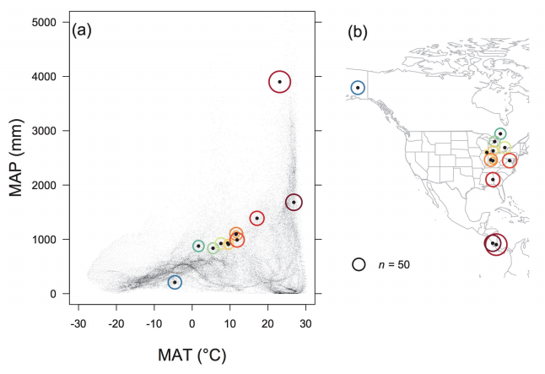
Traits
V_{cmax}
J_{max}
R_{d}
LMA
Leaf N
LWP
Height
DBH
Life history

Slide 3
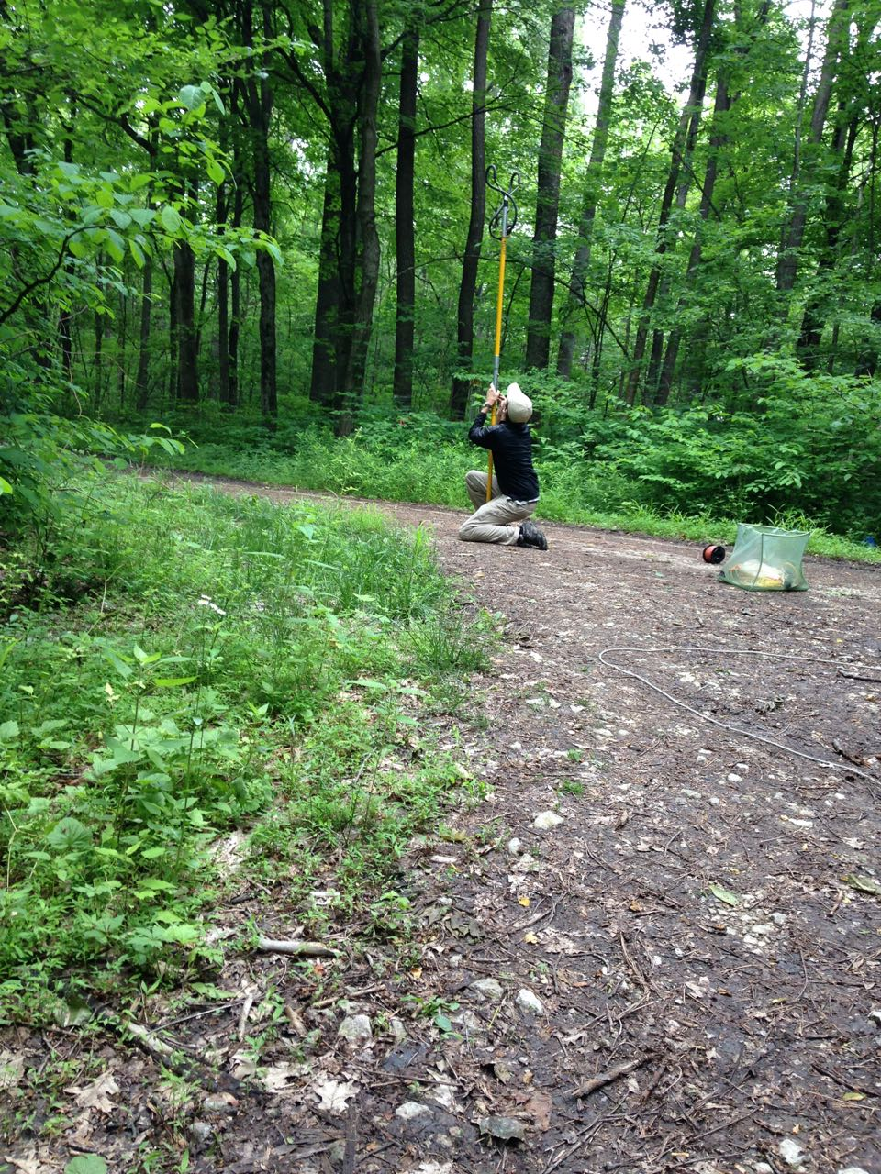
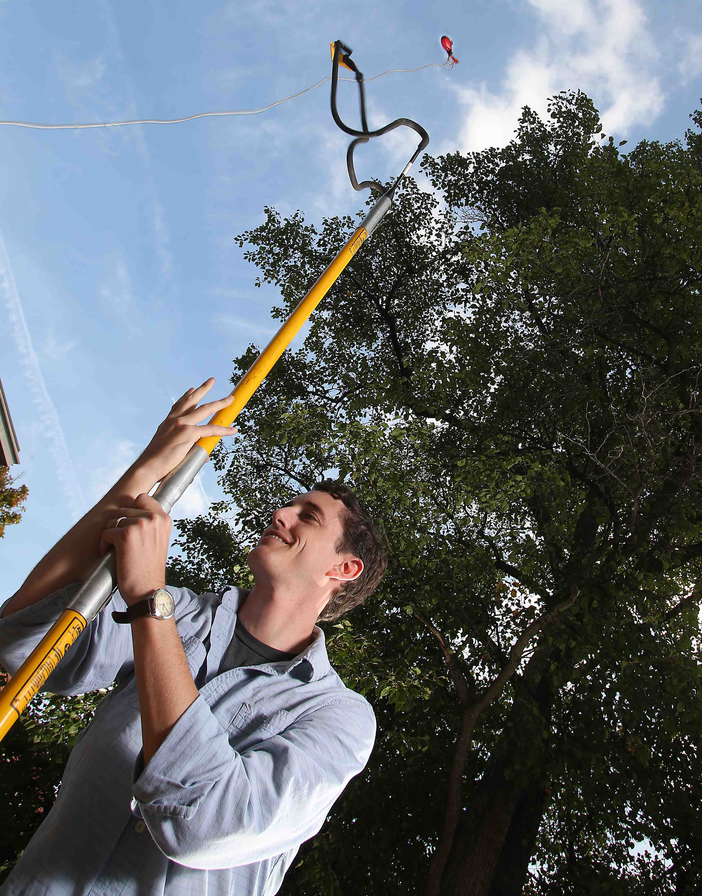

Slide 4
Questions on methodology?

Slide 5
Dry/wet conditions reduce photosynthetic capacity…

Slide 6
…and plants are responding quickly

Slide 7
Fast plant types tend to have faster traits

Slide 8
Juveniles are slower than adults

Slide 9
Hot dry conditions reduce net carbon gain

Slide 10
Any other big takeaways?

Slide 11
Where in the world would you expect the most photosynthesis?

Slide 12
Does this vary over time?

Slide 13
How will photosynthesis change in the future?

